Slide 3
TYPES OF AQUATIC ECOSYSTEM

Slide 13
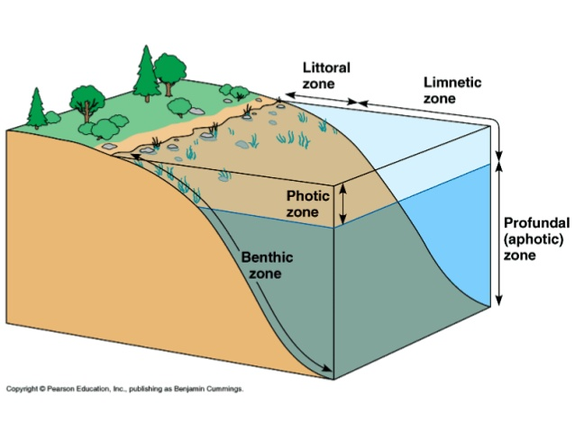

Slide 15
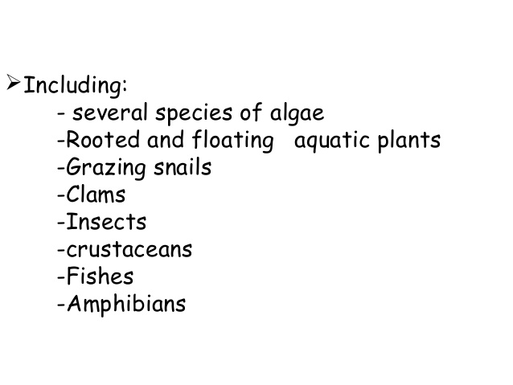

Slide 24
